Slide 1
Wildfires in California
By: Alexander DeLuca, Antoine Edelman, Christian Schroeder, Timothy Tyree

Slide 2
Focus points of the presentation
Why and how we choose this data?
Coding the framework (Dash)
Testing our code
Results we found

Slide 3
Why Californian fires?
We decided to look into Californian fires due to the increasing news of wildfires causing havoc. Could we help people like firefighters and residents.

Slide 4
How we put together our data?
First we found a large dataset containing 1.88 (almost 2) million fire data in the US over 24 years combining several sources. (So that’s a lot of data)
We also gathered precipitation data from NOAA
Filled in missing data and combined it together

Slide 5
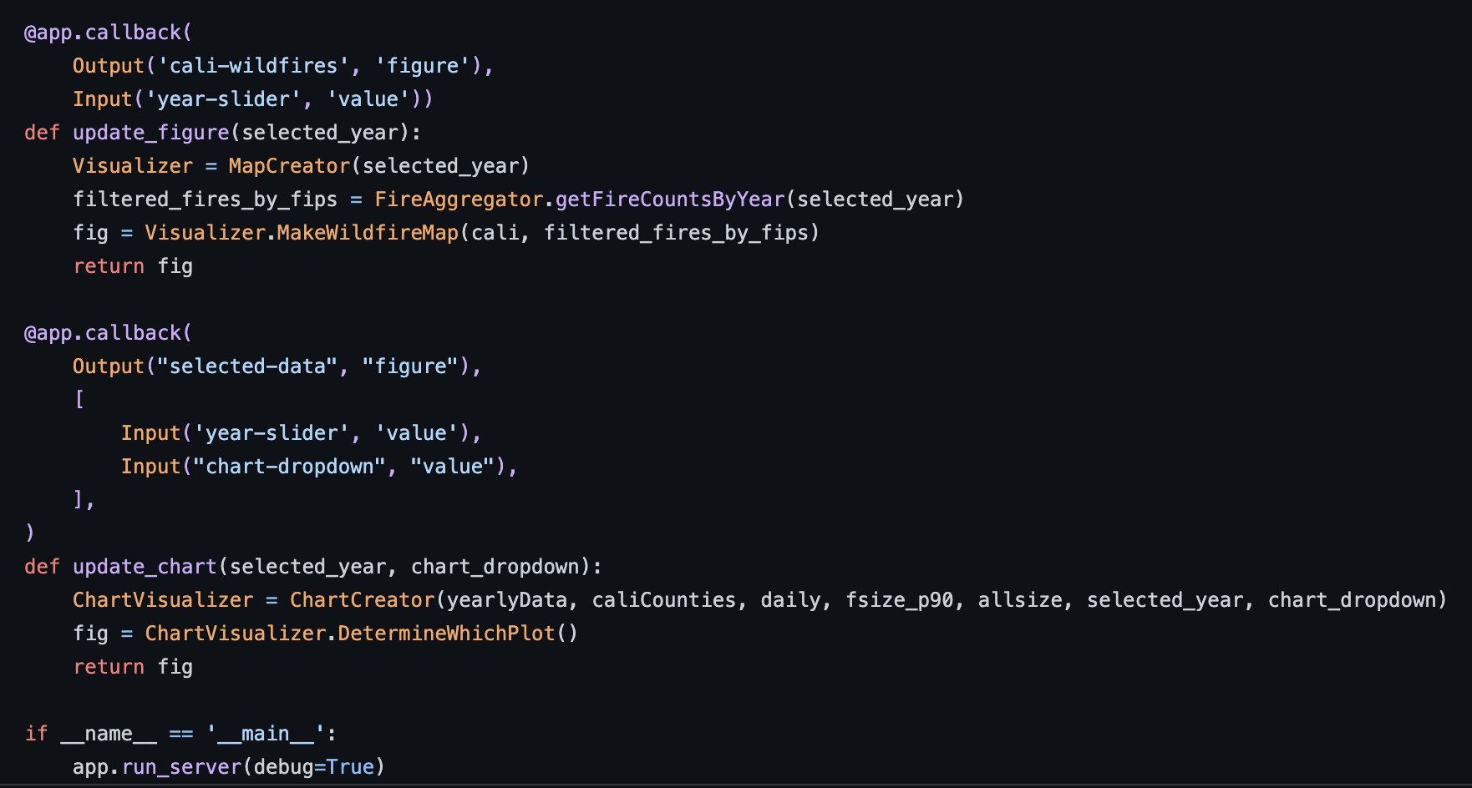
Code: Goal
Dash web application

Slide 6

Code: Preparation
Original code was inefficient and resulted in latency issues (could only use 2003-2015 data)
Optimized our dash app by using object oriented programming

Slide 7
Code: Optimization
2 Data Collection Classes
FirePrecipCollector
Pulls fire, precipitation, and daily data
CaliforniaYearlyCounty
Pulls california geojson objects, and creates a yearly data dictionary with the year as key and fires/geographic data as values.

Slide 8
Code: Optimization
Aggregation Class
Performs all the necessary aggregations outside of the app.py file
Visualization Classes
Map and chart creator classes
Children of aggregations class
Calls the required aggregation and visualizes the results.

Slide 9
Code: Optimization Results
Storing the yearly data in a dictionary resulted in a constant time (average) get method each time the year slider changed.
Separating aggregations allowed the python interpreter to receive vectorized objects
Vastly improved our latency and allowed us to use all of the data (1992-2015).

Slide 10
Unit Testing: What are we testing?
Collection_Aggregation.py
5 classes
23 main functions
Fetches and returns filtered data for visualization

Slide 11
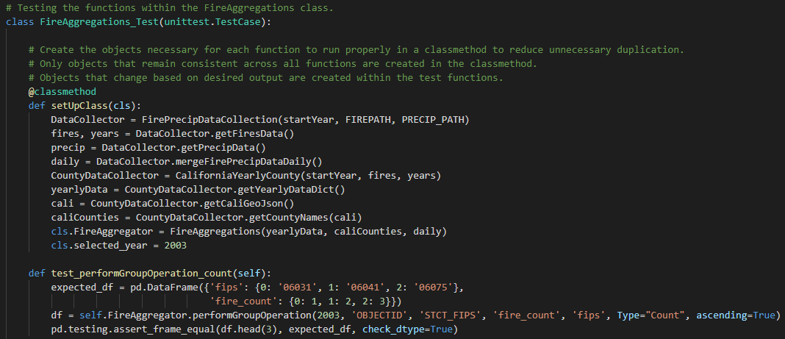
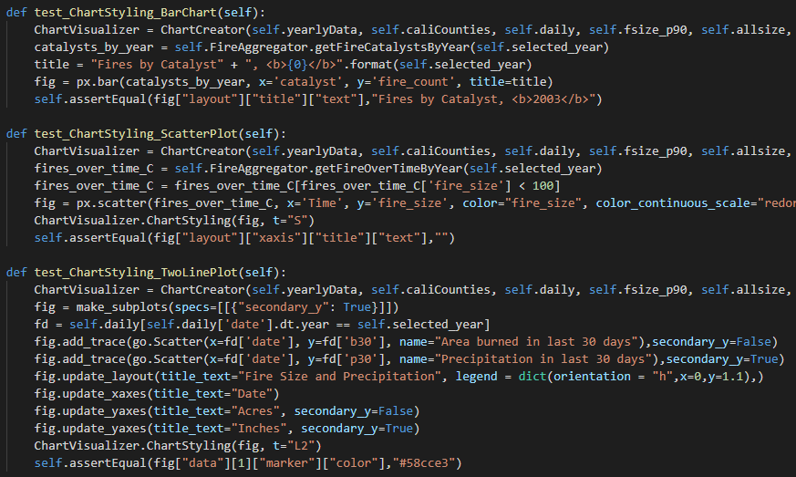
Unit Testing: Classes
4 test classes
38 unit tests
Testing values, shape, parameters, etc.

Slide 12
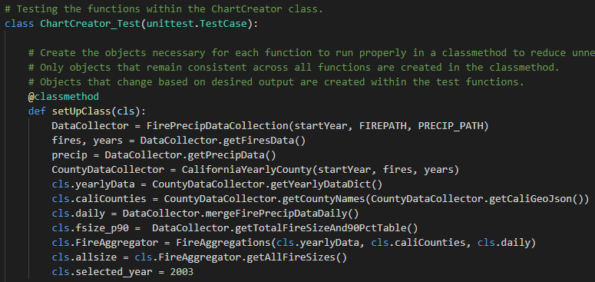
Unit Testing: SetUpClass
Reduce duplication
Set variables required for tests within each class

Slide 13
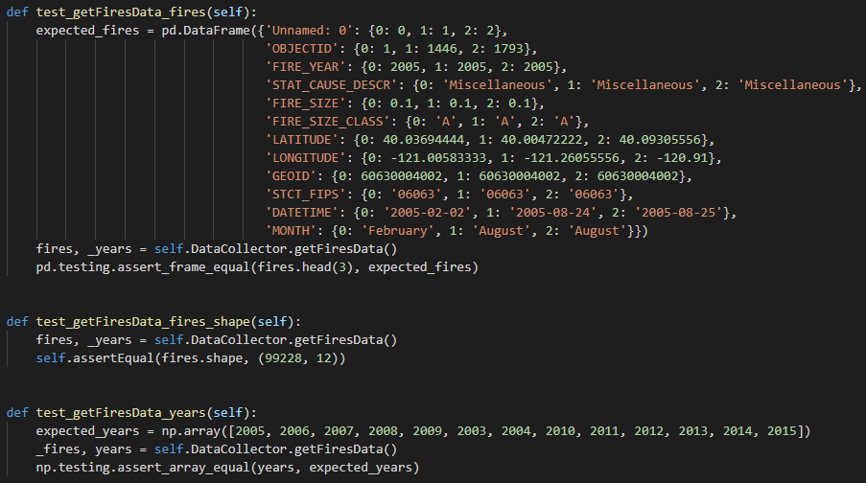
Unit Testing: Expected Values
Exact data based on index
Shape
Populated variables

Slide 14
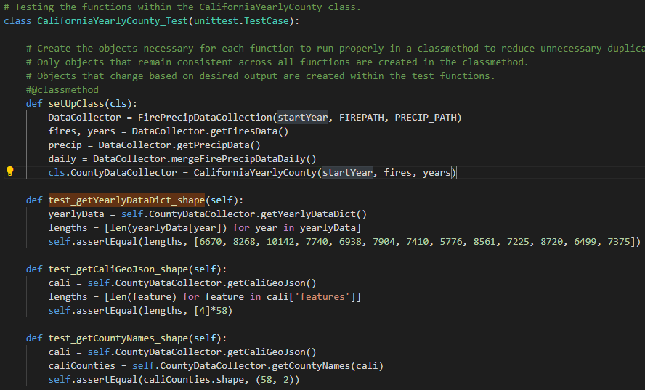
Unit Testing: Expected Values
Exact data based on index
Shape
Populated variables

Slide 15
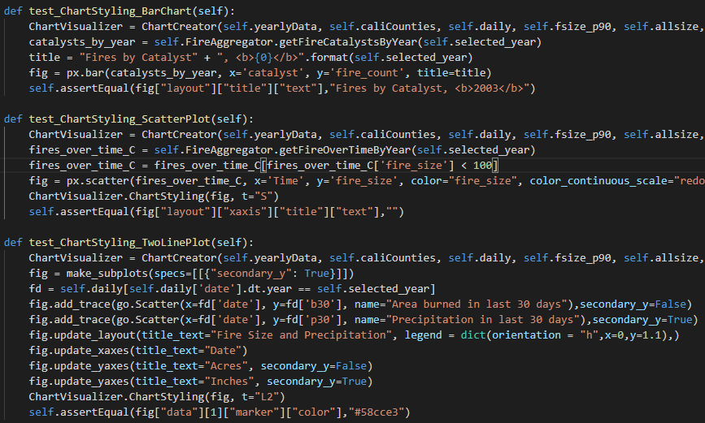
Unit Testing: ChartStyling
Confirm the proper figure layout parameters are being passed

Slide 16
Unit Testing: Results
Testing each function for the proper returned data, populated variables, and parameters confirmed our application was running as intended.
This confirmation allowed us to start focusing on the functionality and usability of the application

Slide 17
Conclusion
Size does matter (in fire analysis)
Add financial data and a heat map.
Thanks to Dr. Fox and the TAs!

Slide 18
Questions?

